Slide 1

Restaurant Billing & Online Reservation System
Ottawa, Canada

Slide 2
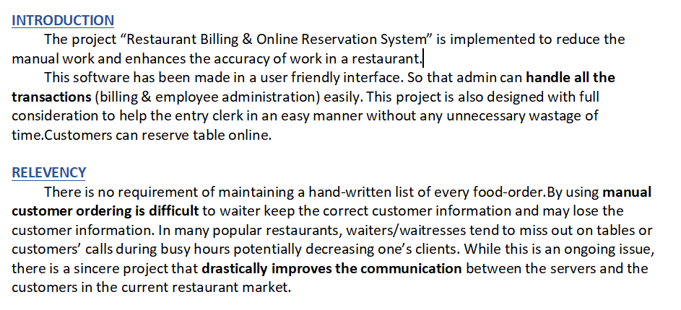
Abstract

Slide 3
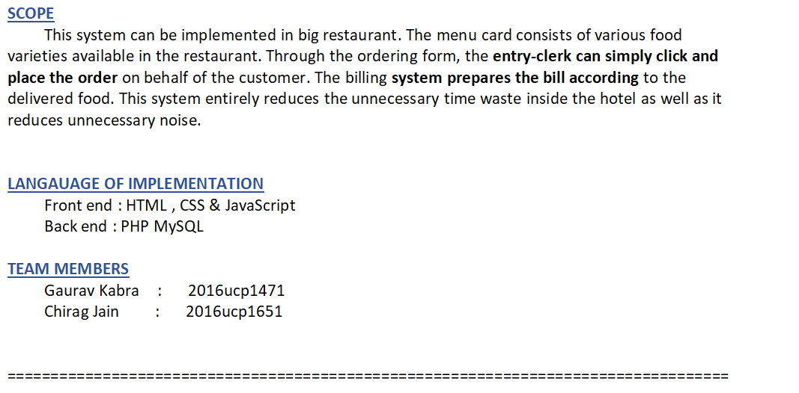
...contd

Slide 4
Relational Schema
admin(username PK,password)
employee(username PK)
earning(Earning ,Time PK)
reserve(name,email PK,date,msg)
item(food PK,price)
subscriptions(email PK)
availability_table(date_ PK,count)

Slide 5
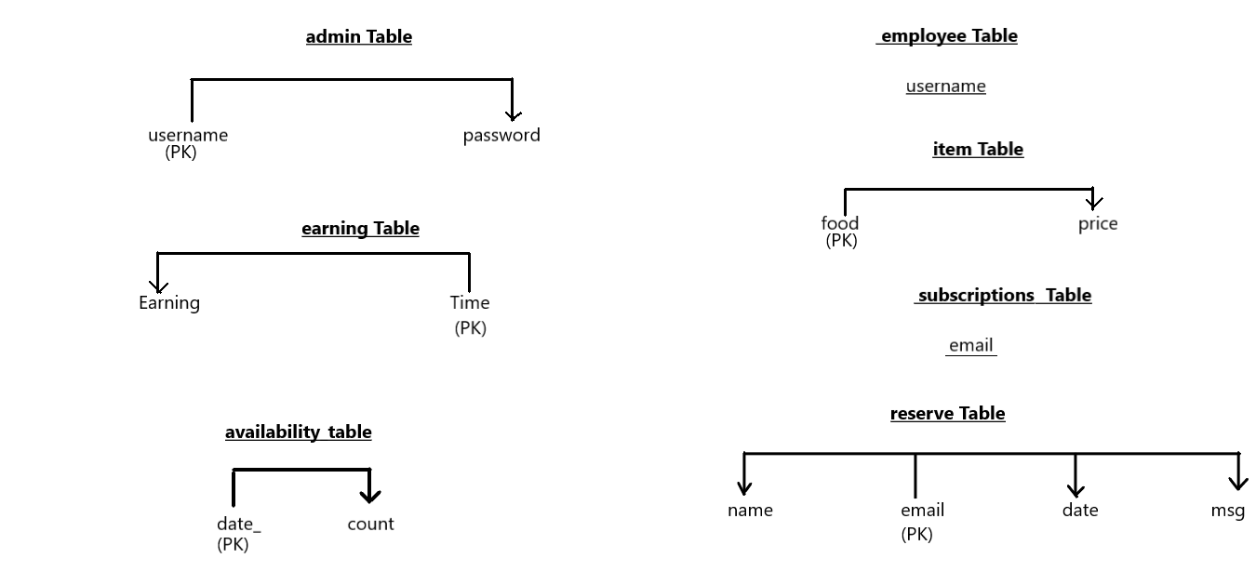
Table Dependencies

Slide 6
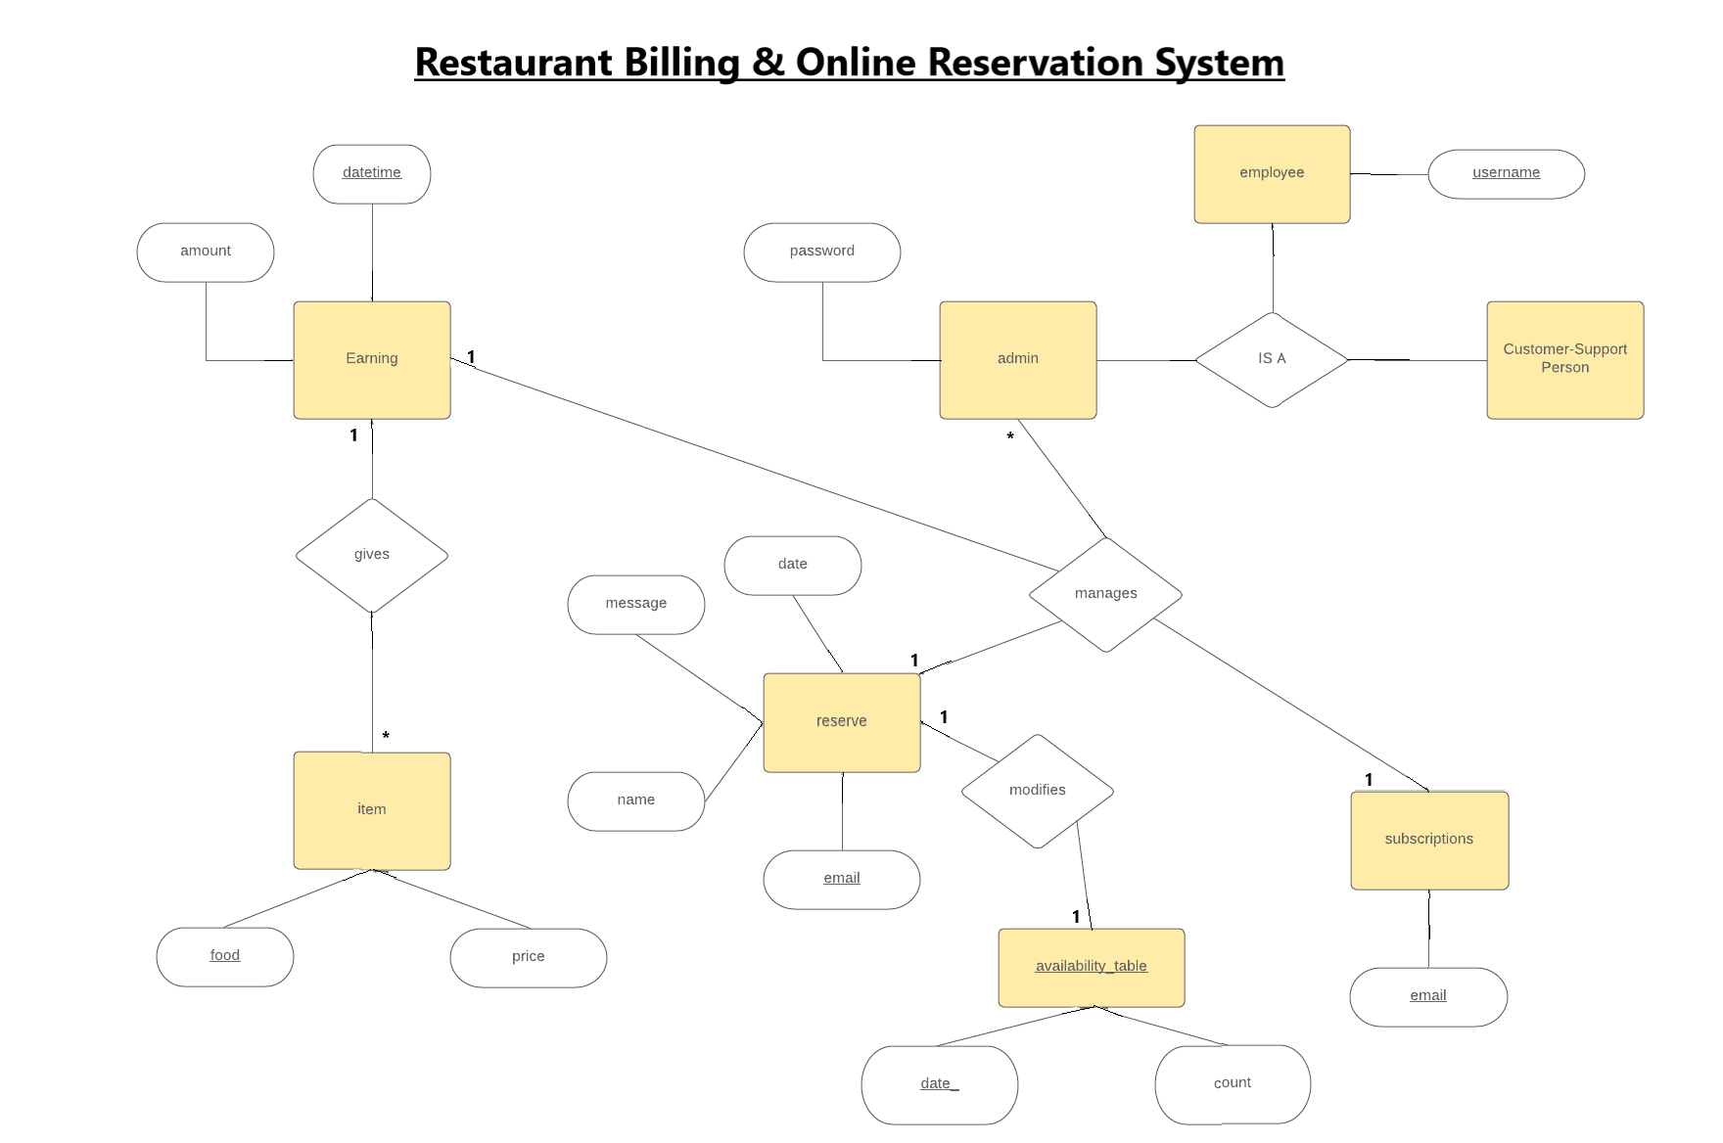
Entity-Relationship Diagram

Slide 7
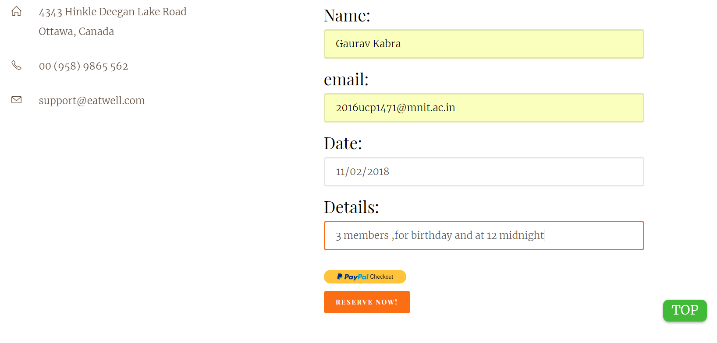
Functionalities
(1) Customer Online Table Reservation

Slide 8
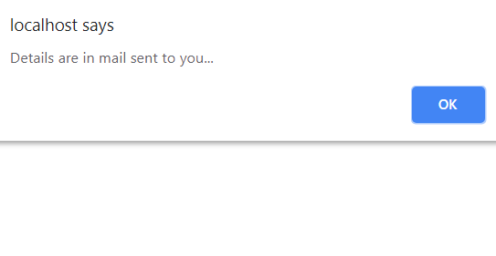
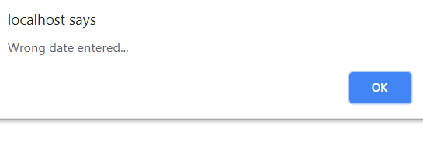
...

Slide 9
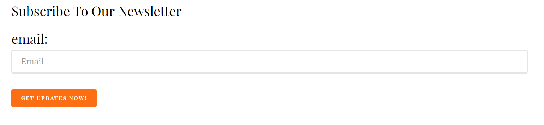
...
(2) Subscription

Slide 10
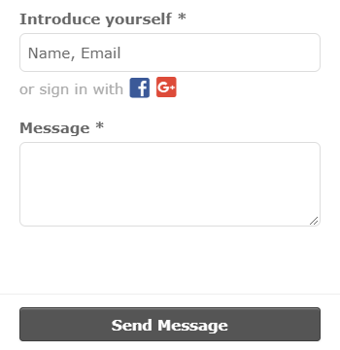
...
(3) Online Chat Support

Slide 11
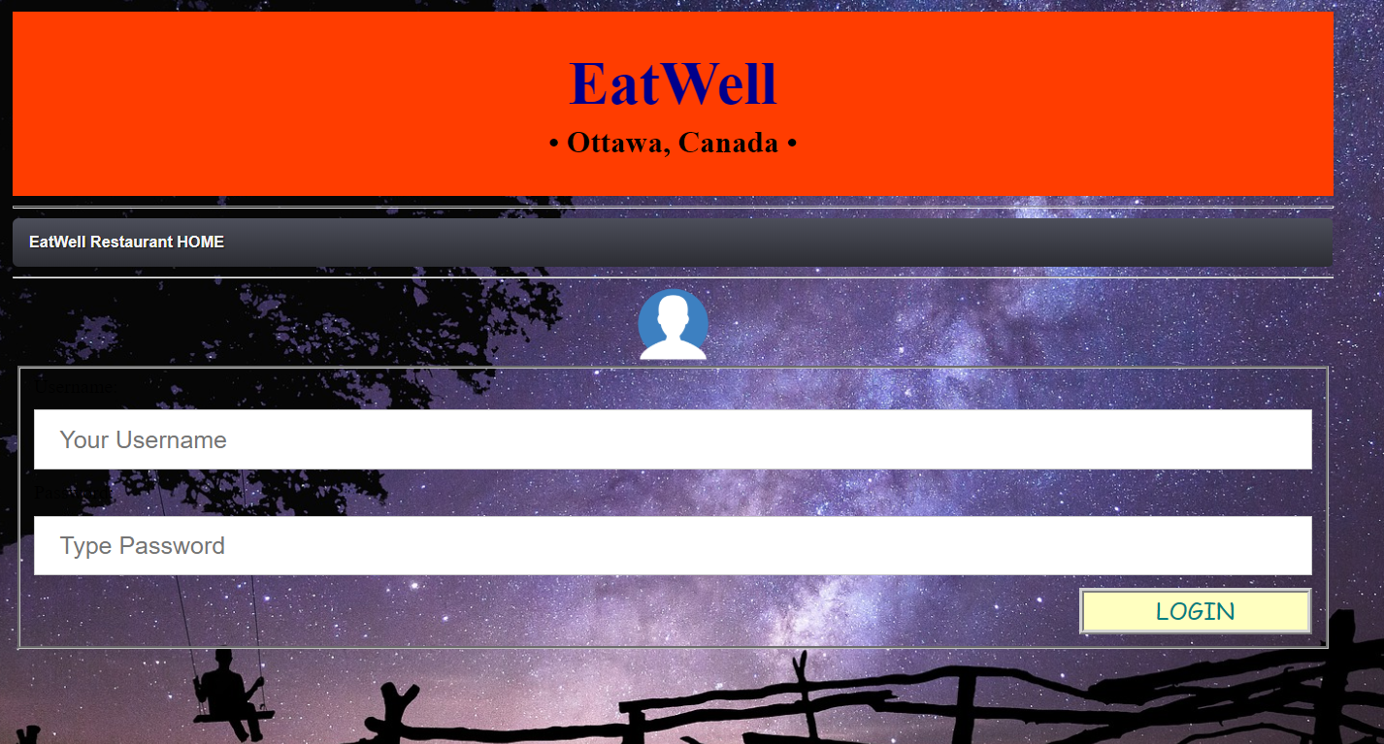
...
(4) Admin Login Screen

Slide 12
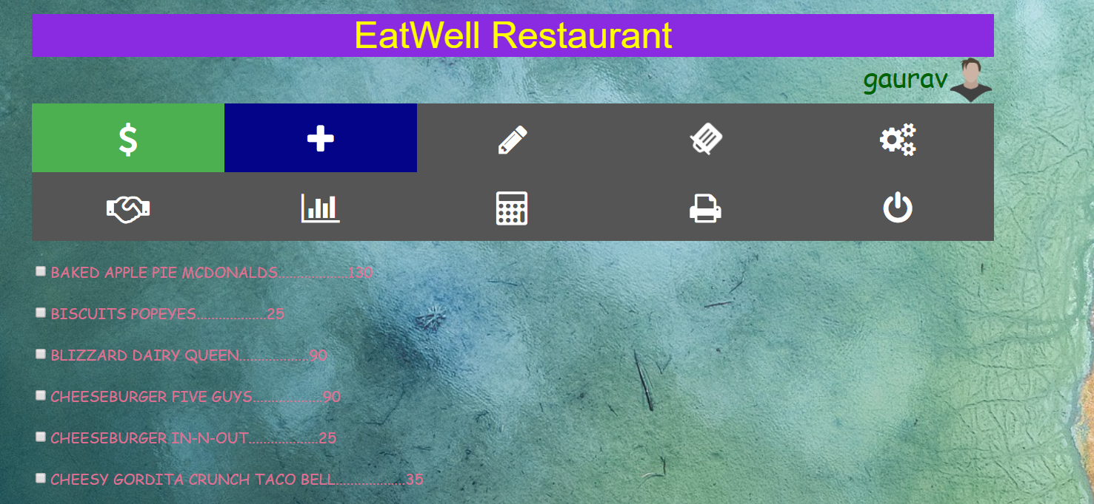
...
(5) Billing System

Slide 13
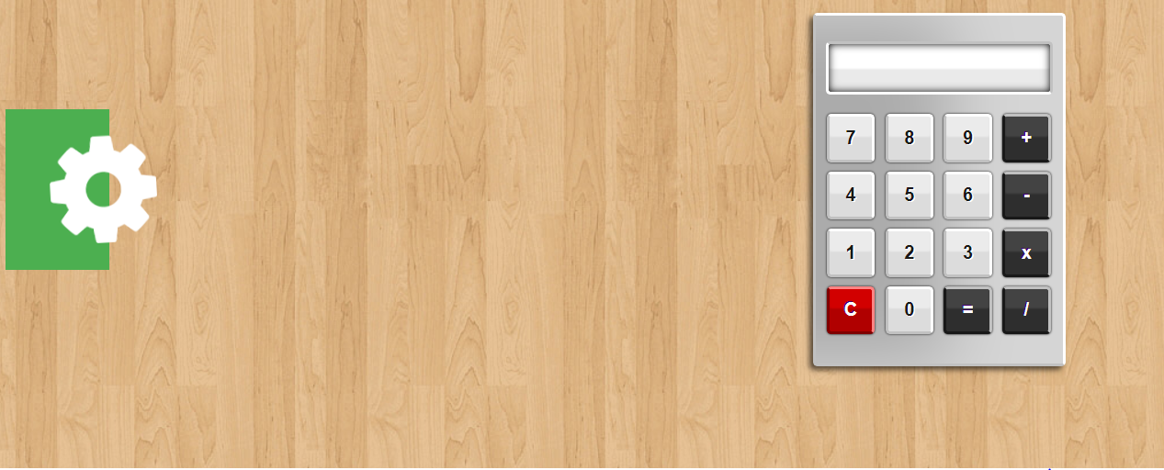
...

Slide 14
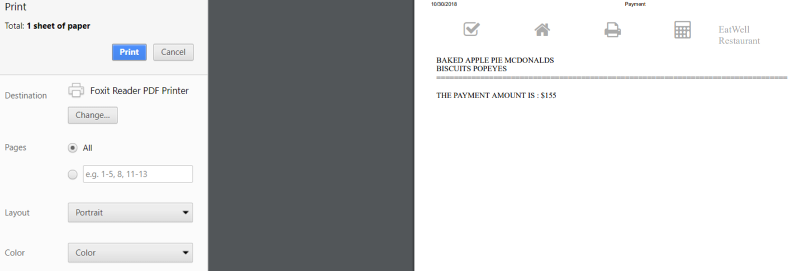
...

Slide 15
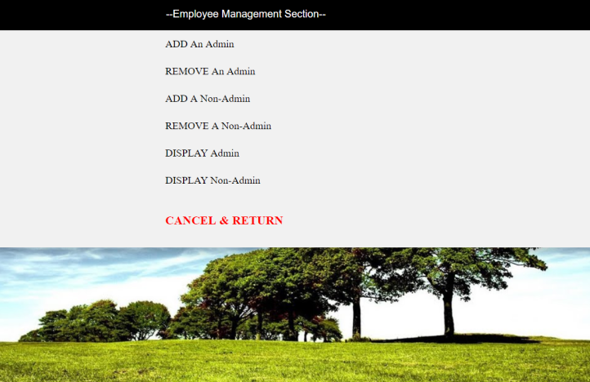
...

Slide 16
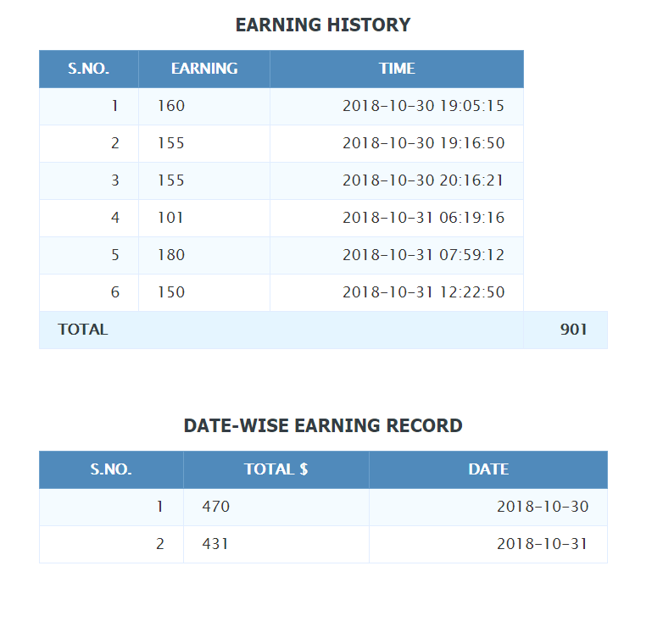
...

Slide 17
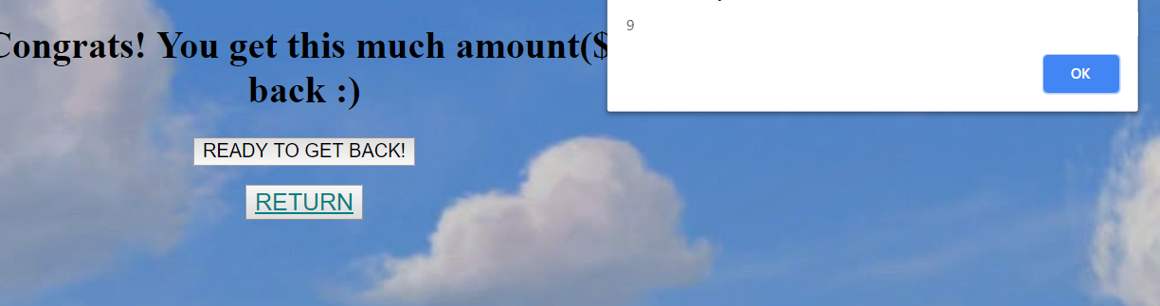
...

Slide 18
Gaurav Kabra 2016 ucp 1471 Chirag Jain 2016 ucp 1651

